Slide 1




Parent-Teacher Communication App (PTC)
"Bridging the gap between parents and teachers for student success"
BY: Nelisiwe Gama
Contacts: 071 962 4110
nelisiwegama2@gmail.com

Slide 2


Lack of Effective Communication Between Parents and Teachers
Miscommunication or delayed communication
Difficulties in scheduling meetings and sharing updates
Lack of a central platform for progress tracking and collaboration

Slide 3




How can we improve communication between parents and teachers for better student outcomes?
Instant messaging for real-time updates
Progress tracking and report sharing
Easy meeting scheduling with reminders
Centralized platform for collaboration on student learning and development

Slide 4



Key Features
Messaging: Direct, secure messaging between parents and teachers
Progress Updates: Track and share student progress, assignments, and behavior reports
Scheduling: Simplified meeting scheduling with built-in calendar and reminders
Collaboration: Tools to support joint efforts in student development, from goal-setting to feedback sharing

Slide 5


Step 1: Sign up and create a profile (parent, teacher)
Step 2: Add students and connect with respective teachers/parents
Step 3: Send/receive messages, share updates, and schedule meetings
Step 4: Monitor student progress collaboratively
How It Works
Enhancing Engagement Together

Slide 6
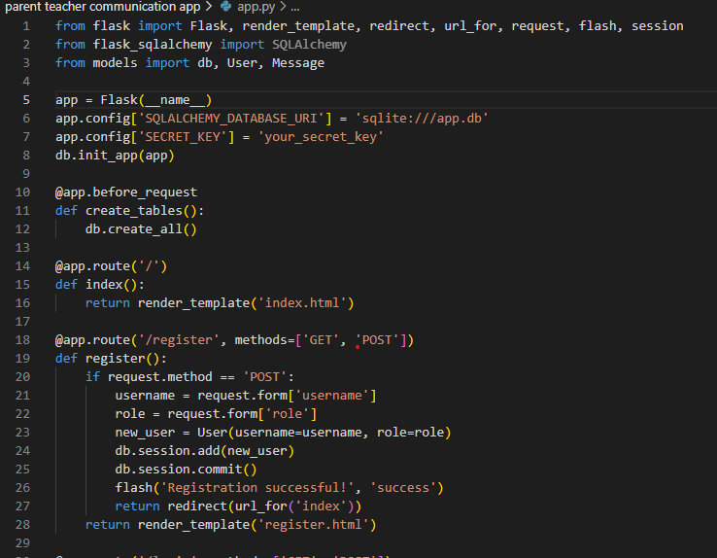
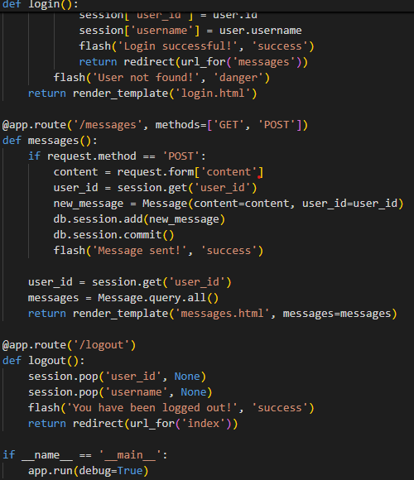
How It Works
CODE

Slide 7



Target Market
Parents: Seeking active involvement in their child’s education
Teachers: Needing streamlined communication with parents
Schools: Looking for efficient tools to improve engagement with parents

Slide 8


Competitive Advantage
All-in-one Solution: Combines messaging, progress tracking, and meeting scheduling
User-friendly Interface: Easy for both tech-savvy and less tech-savvy users
Security: End-to-end encryption ensures privacy of student data and communications

Slide 9
Revenue Model
Freemium Model:
Basic features available for free
Premium subscription for advanced features (e.g., analytics, custom reporting, more storage, etc.)
School Partnerships: Bulk subscriptions for schools and districts
Advertising: Optional, relevant advertising for educational products and services

Slide 10
Traction & Milestones
Beta Launch: (e.g., number of users, schools signed up)
User Feedback: Positive testimonials from parents and teachers
Next Steps: Planned feature enhancements and partnerships

Slide 11
THANK YOU

